Slide 1
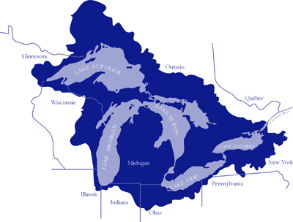
DOCUMENTING THE OCCURRENCE THROUGH SPACE &TIME
OF AQUATIC NON-INDIGENOUS
FISH, MOLLUSKS, ALGAE, & PLANTS
THREATENING NORTH AMERICA’S GREAT LAKES
Ken Cameron
Wisconsin State Herbarium (WIS)
Department of Botany
University of Wisconsin-Madison
kmcameron@wisc.edu

Slide 2
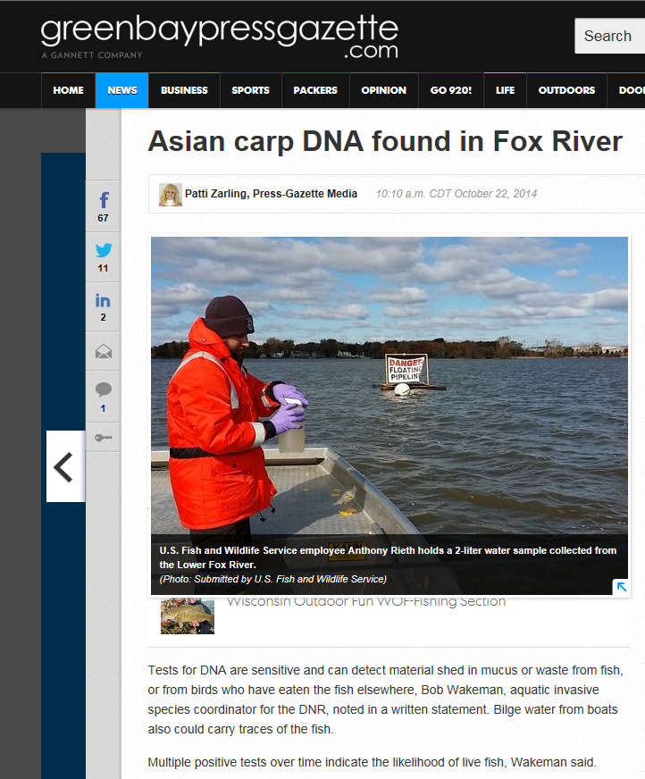
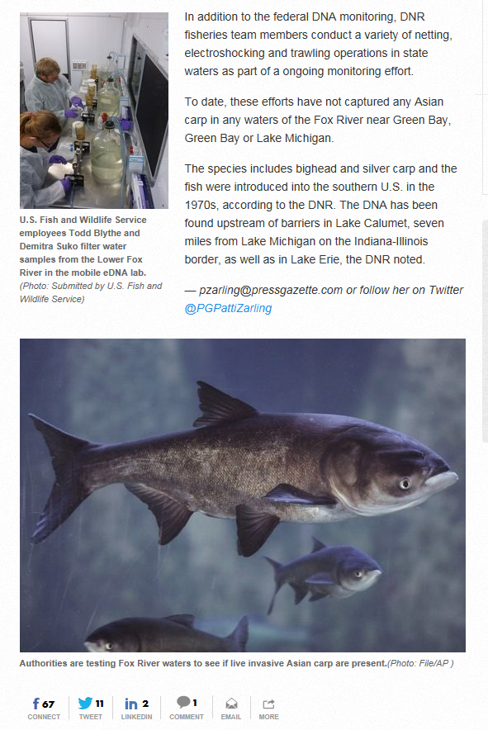
October 22, 2014

Slide 3
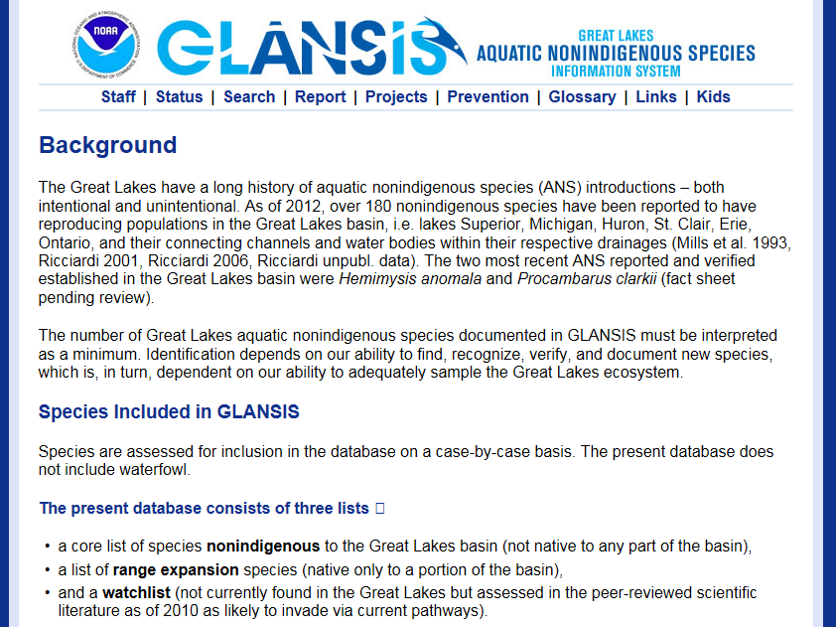
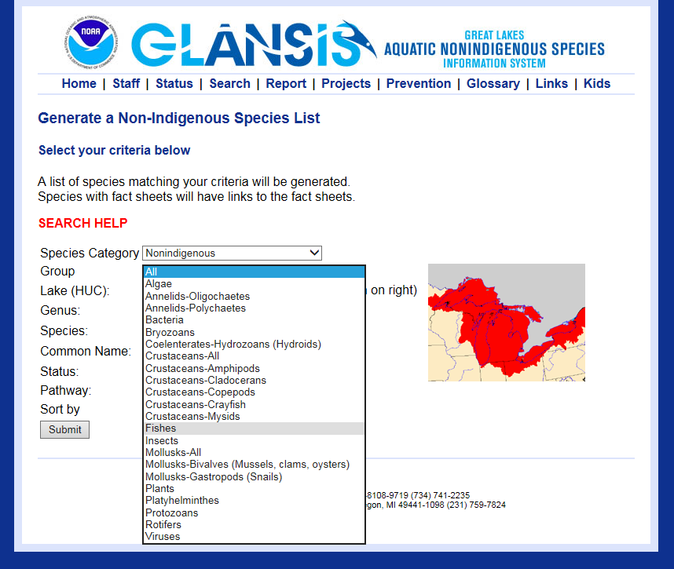

Slide 4
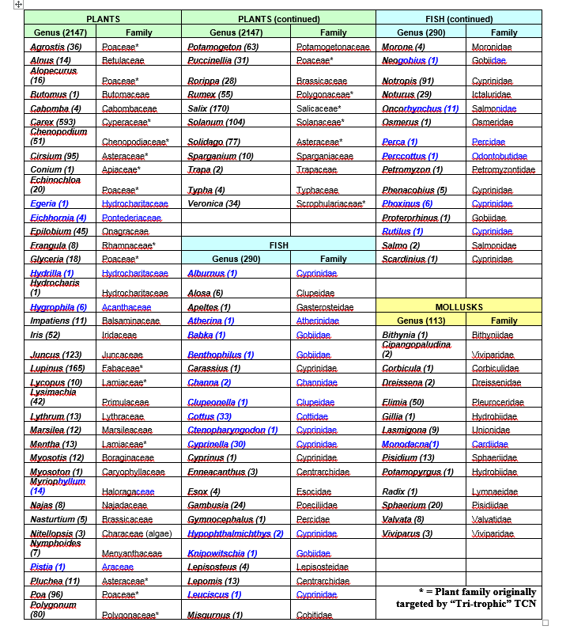
Target Genus
Watchlist Genus
(no. spp. In North America)
2,550 species
101 genera

Slide 5
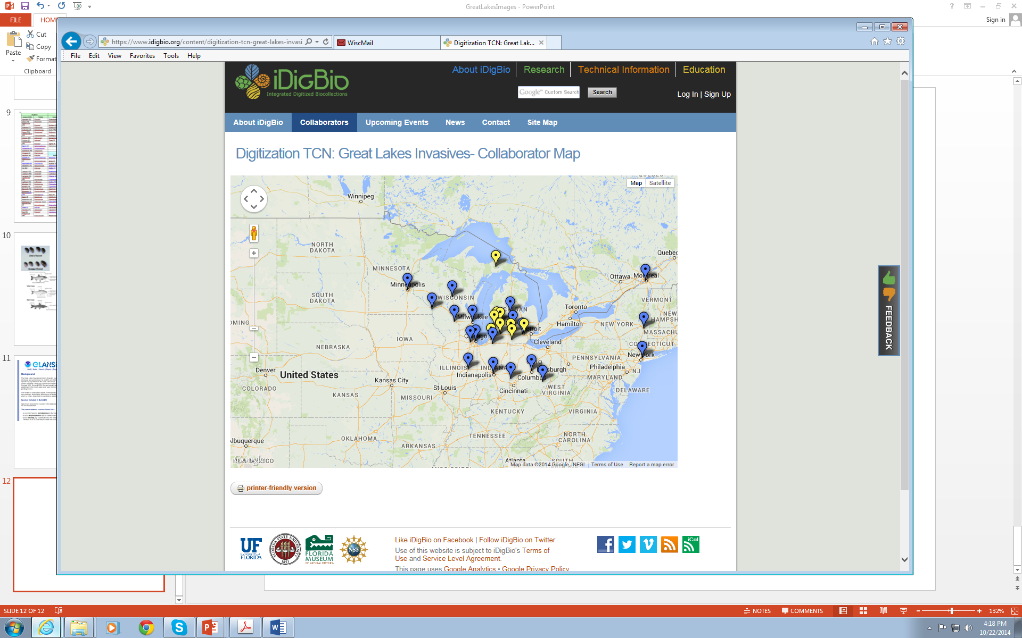
1. Univ of WI-Madison (WIS)
2. Univ of WI-Steven’s Point
3. Univ of WI-Milwaukee
4. Univ of WI-LaCrosse
5. University of Minnesota 6. Michigan State Univ
7. Field Museum (F / FMNH)
8. University of Illinois / ILNHS
9. Morton Arboretum ***
10. University of Notre Dame
11. Butler University
12. Univ of Michigan (MICH)
13. Western Michigan Univ
14. Central Michigan Univ 15. MI Small Herbaria Network ++
16. Miami University
17. Ohio State University
18. Ohio University
19. NY Botanical Garden (NY)
20. New York State Museum 21. Université de Montréal 22. AZ State Univ / Symbiota

Slide 6
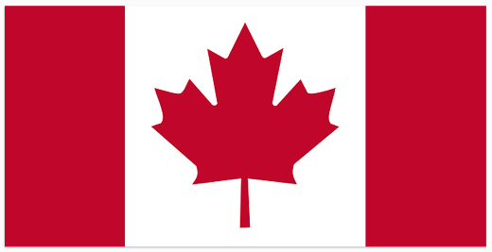
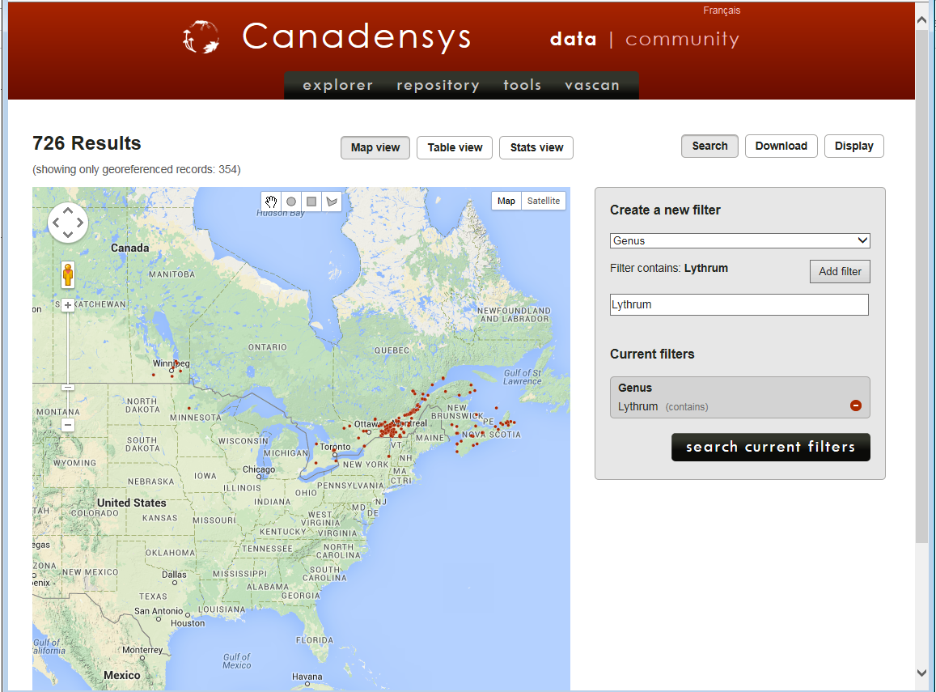

Slide 7
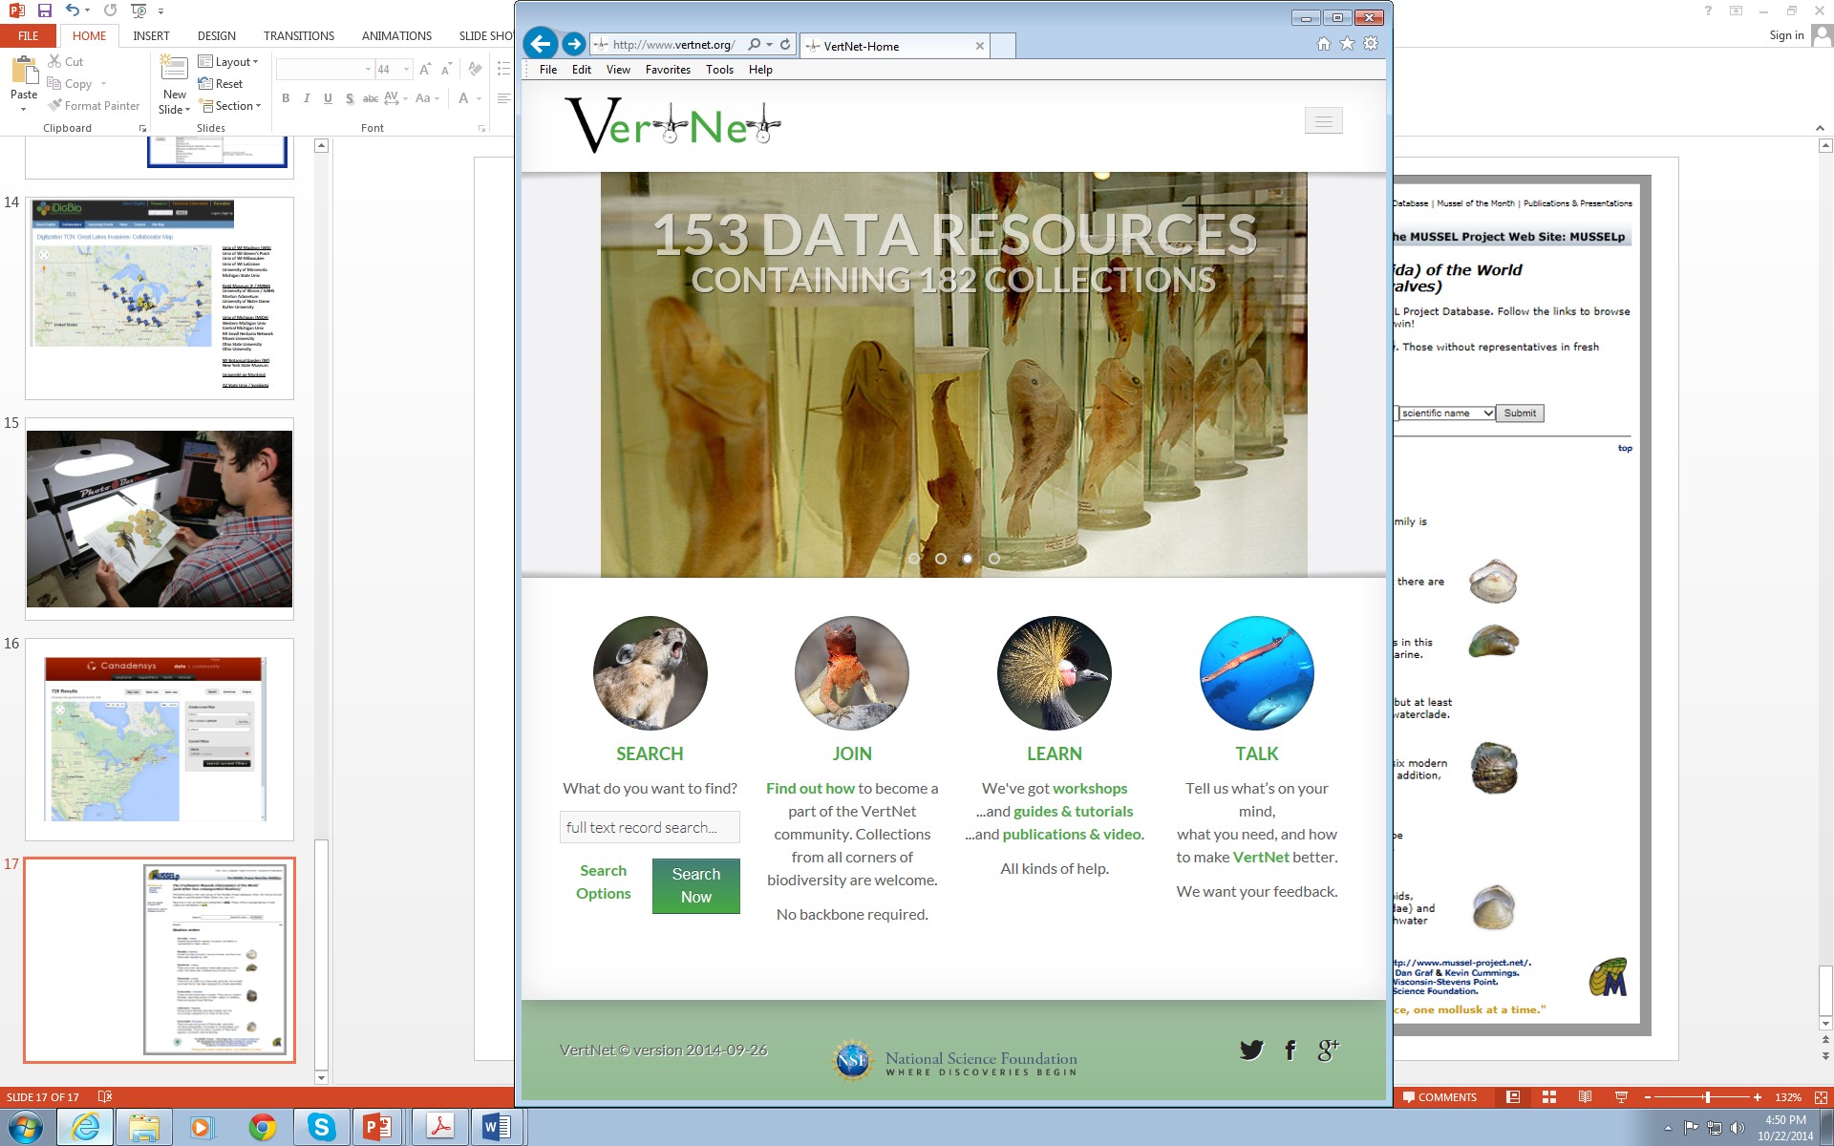
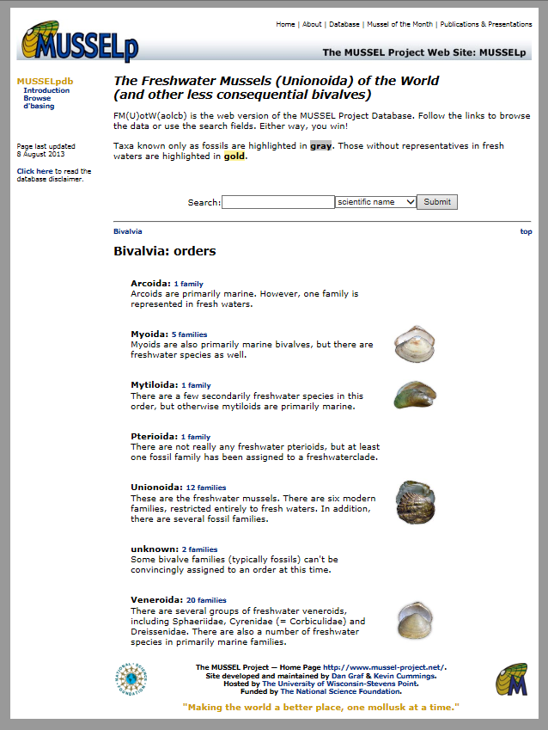

Slide 8
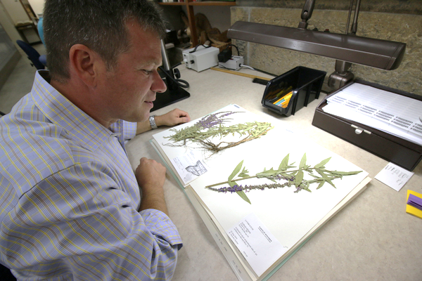
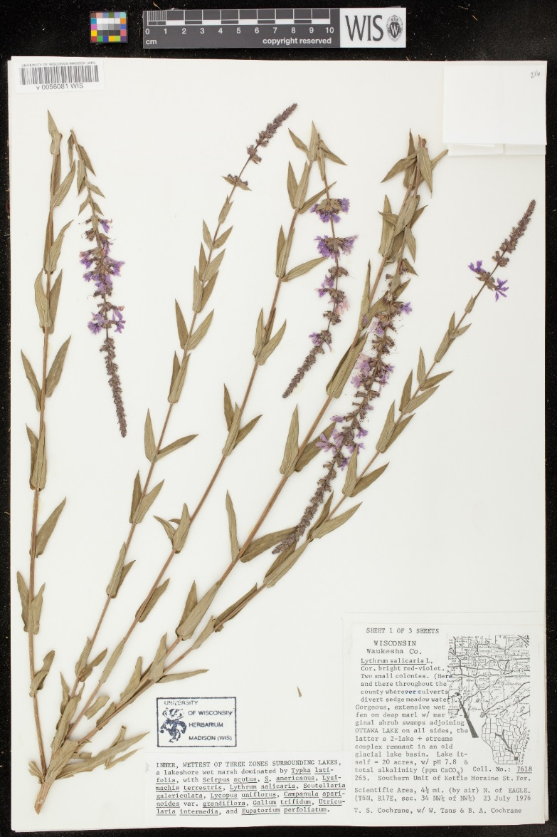

Slide 9
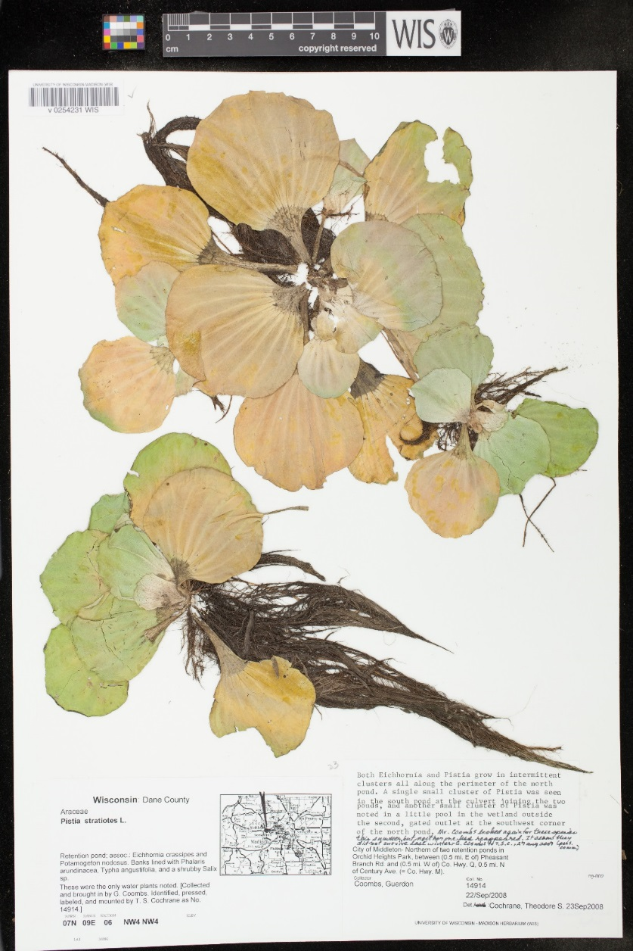
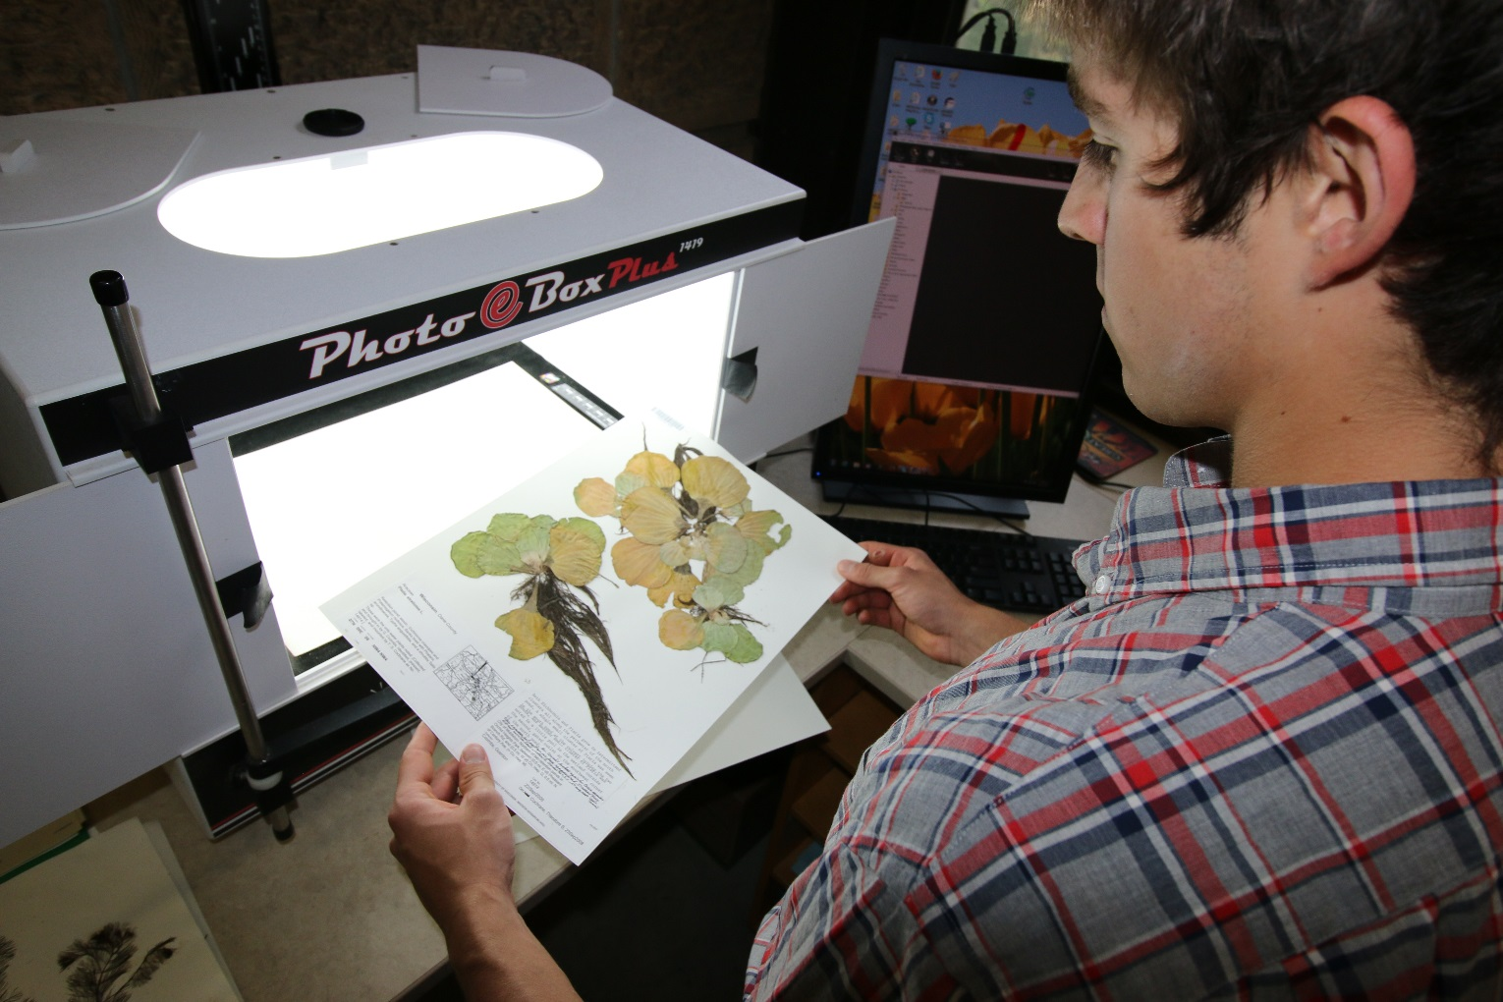

Slide 10
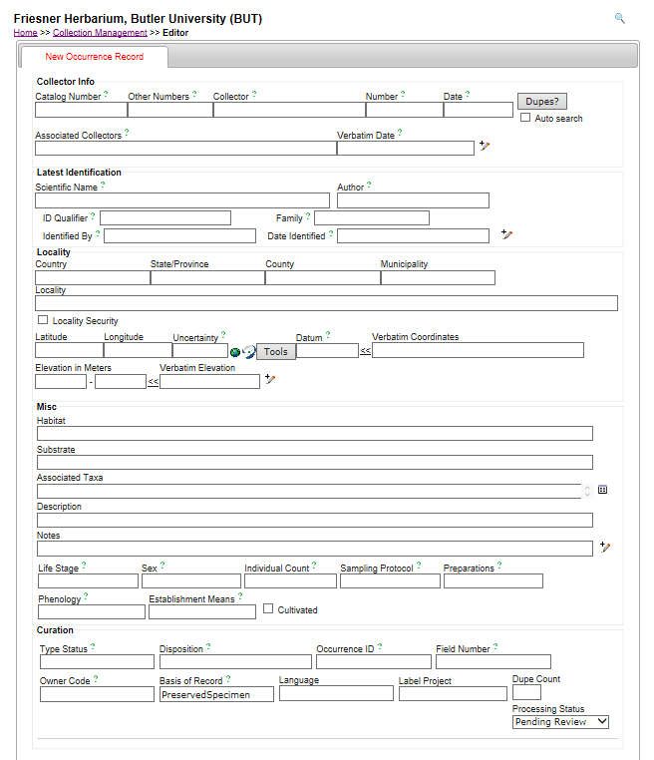
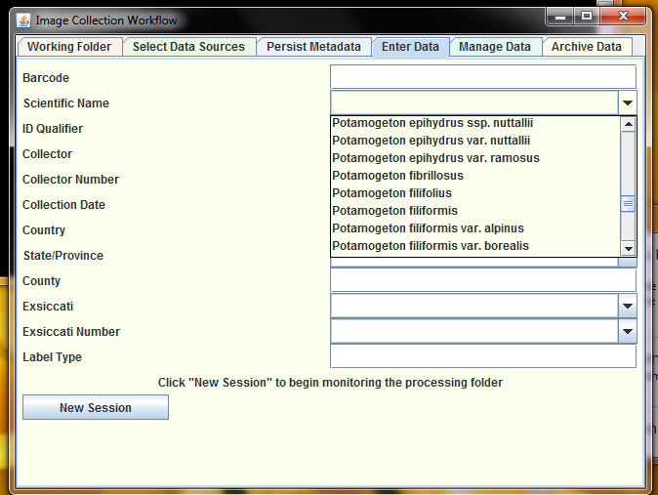
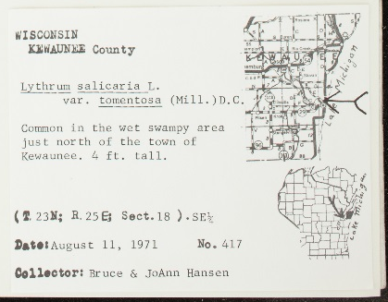
1. Skeletal record is created by imagers
2. Label data is extracted via OCR
ï»¿UNIVERSITY OF WISCONSIN-MADISON (WIS)
v 0047793 WIS
. MAPPED ÃŒ072 FLORA OF WISCONSIN
WISCONSIN KJiWAUNME County
(T. 23N; B. 25 Ei Sect. 18 ).SE%
August 11, 1971 No. 417
Collector: Bruce & JoAnn Hansen
Lythrum salicaria L.
var. tomentosa
(Mill. )D.C
Common in the wet swampy area just north of the town of Kewaunee. 4 ft. tall.
3. Data is parsed and edited in
Symbiota by regional data managers
4. Fed to / ingested by iDigBio

Slide 11
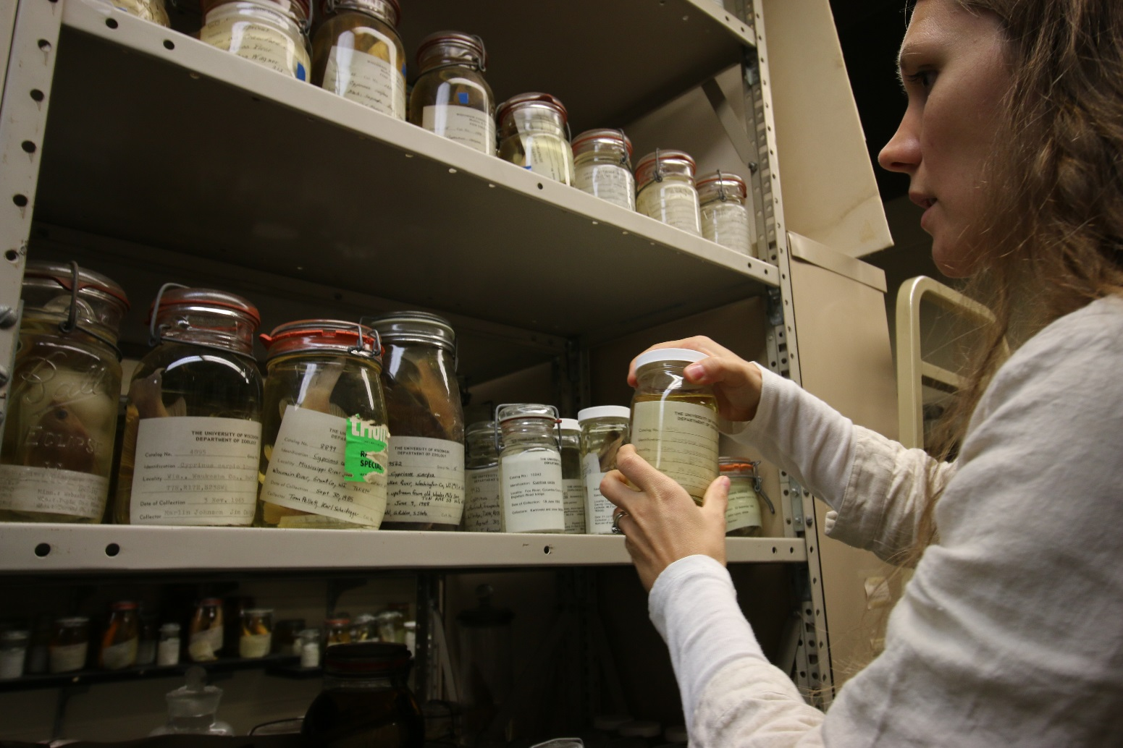
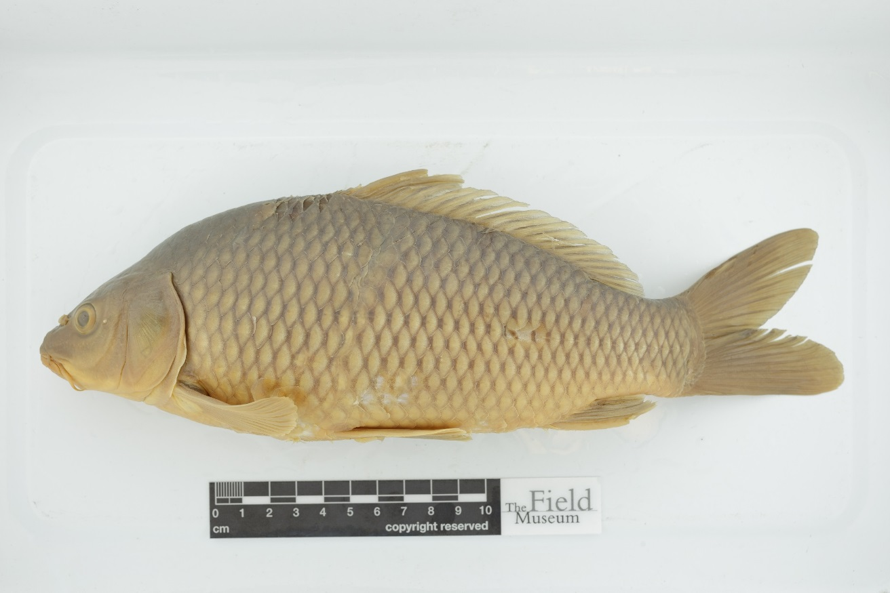

Slide 12
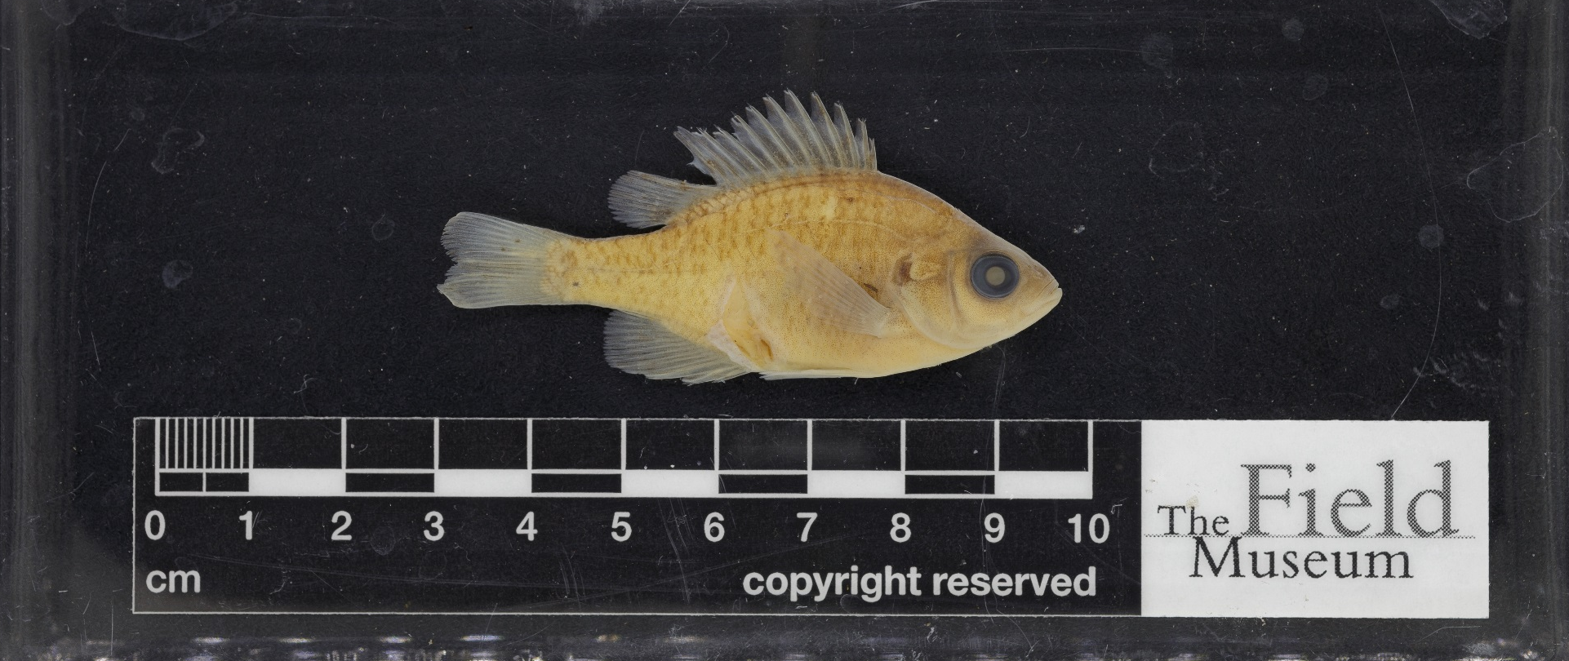
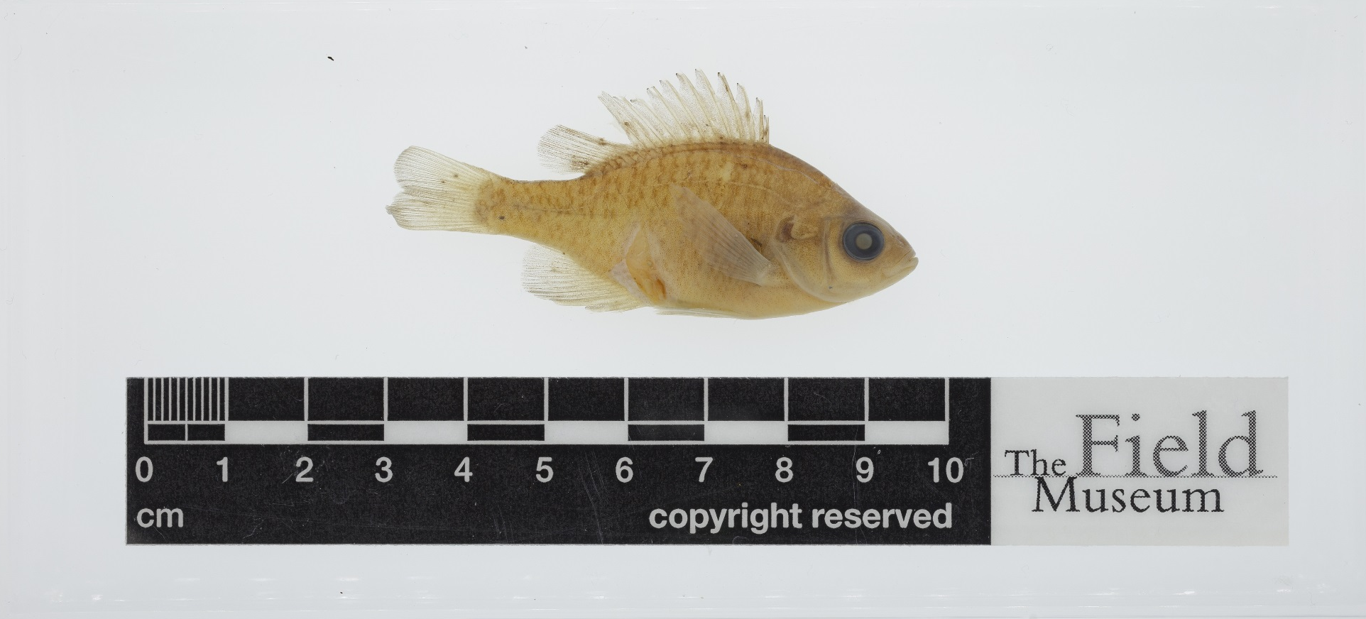

Slide 13
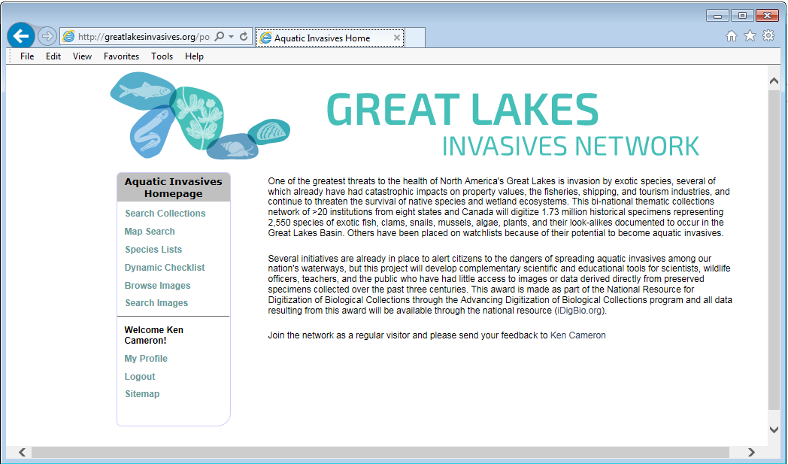
GreatLakesInvasives.org

Slide 14
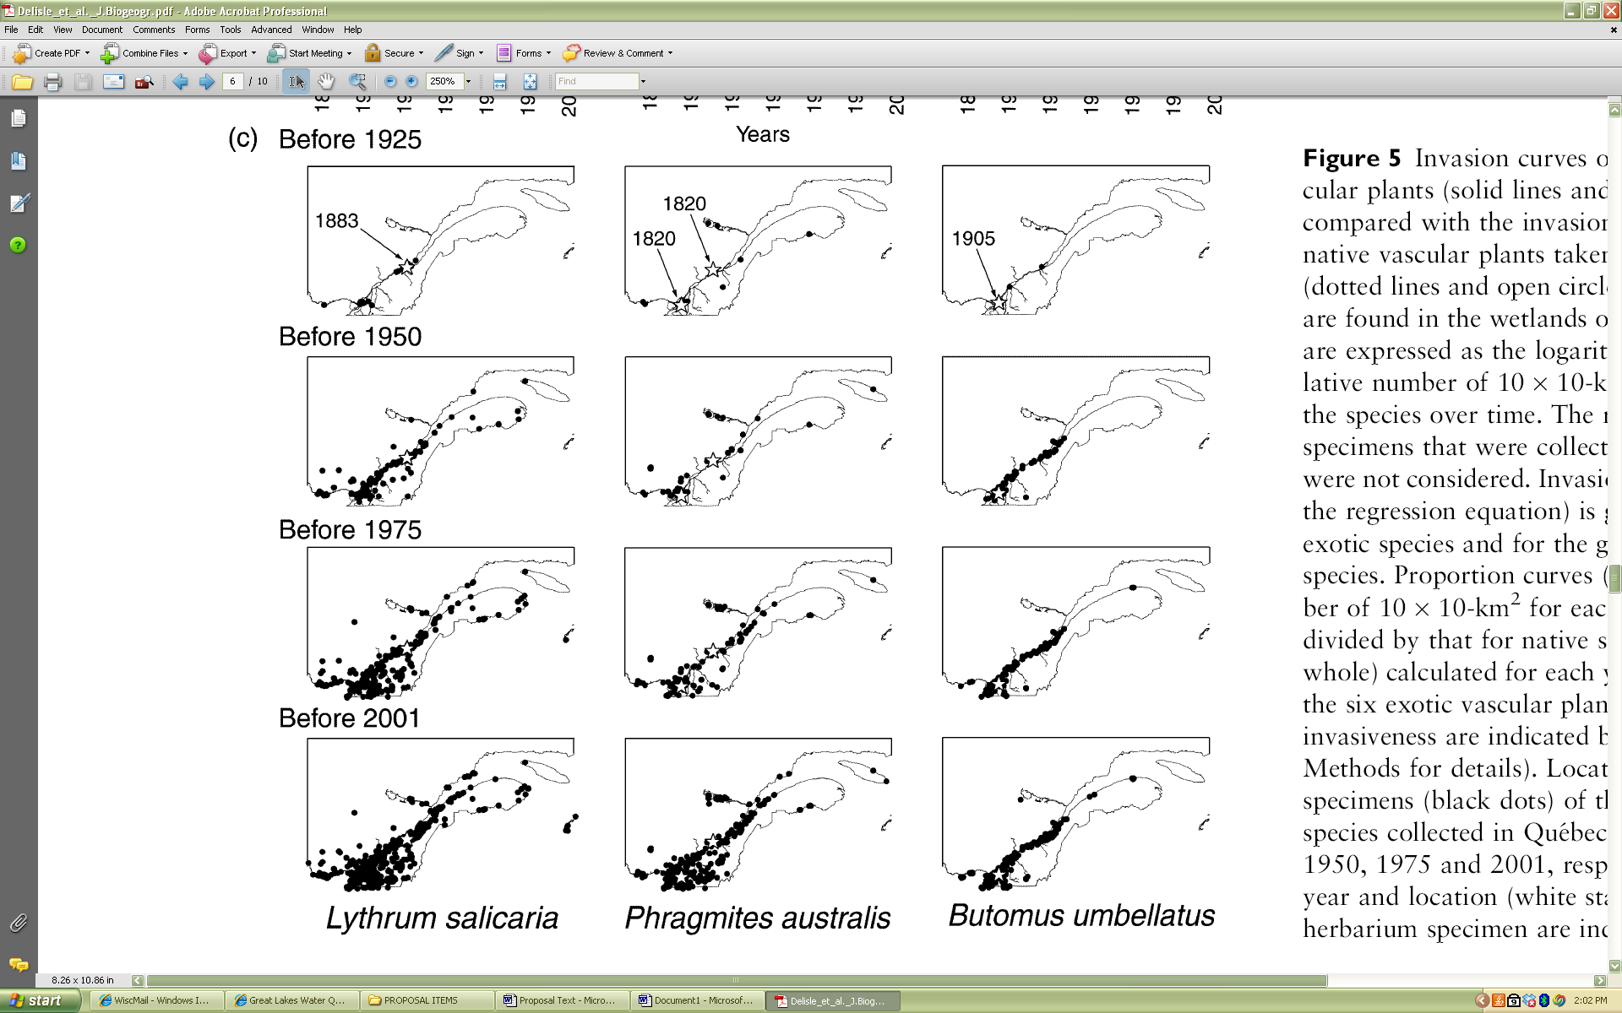
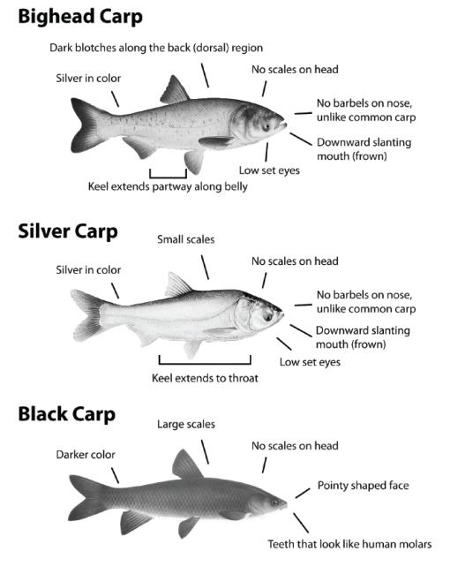
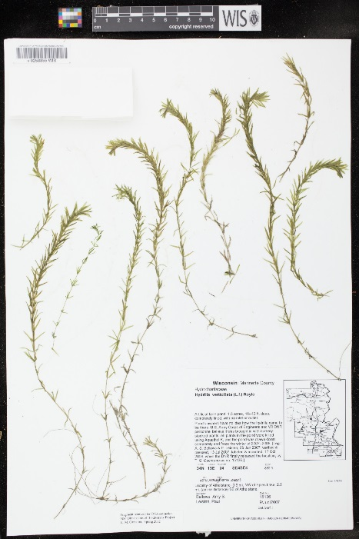
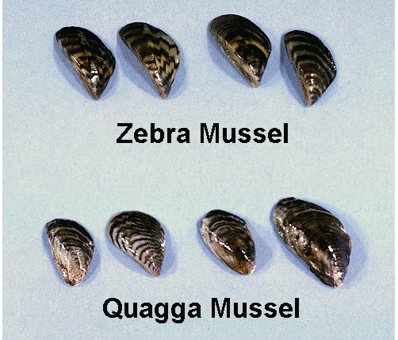
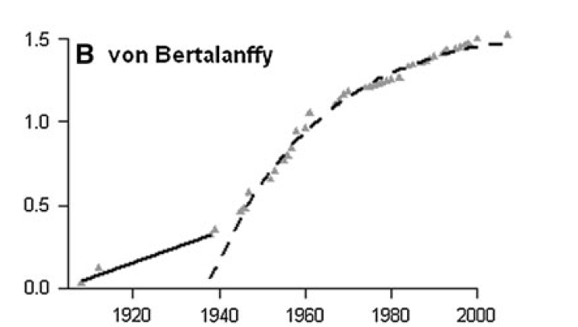
Potential Research Applications
Points of Origin and
Patterns of Invasion
Occurrence Data
Based on Vouchers!
Using Specimens to
Recognize the
Good from the Bad
Lag Time

Slide 15
